Slide 1
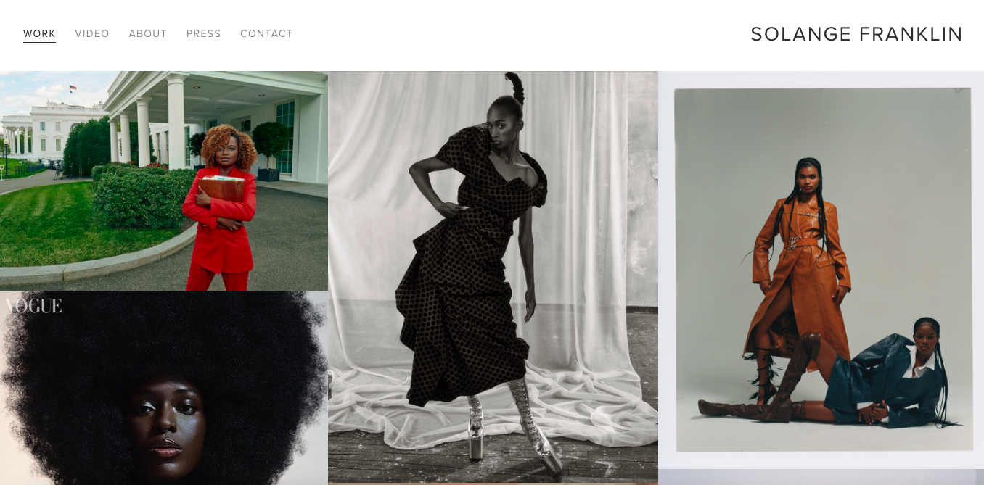
HOMEPAGE IS ENDLESS SCROLL - SHOWING WORK - USE ‘SEEN ON’ PAGE AS HOMEPAGE
https://www.shionaturini.com/home-page

Slide 2
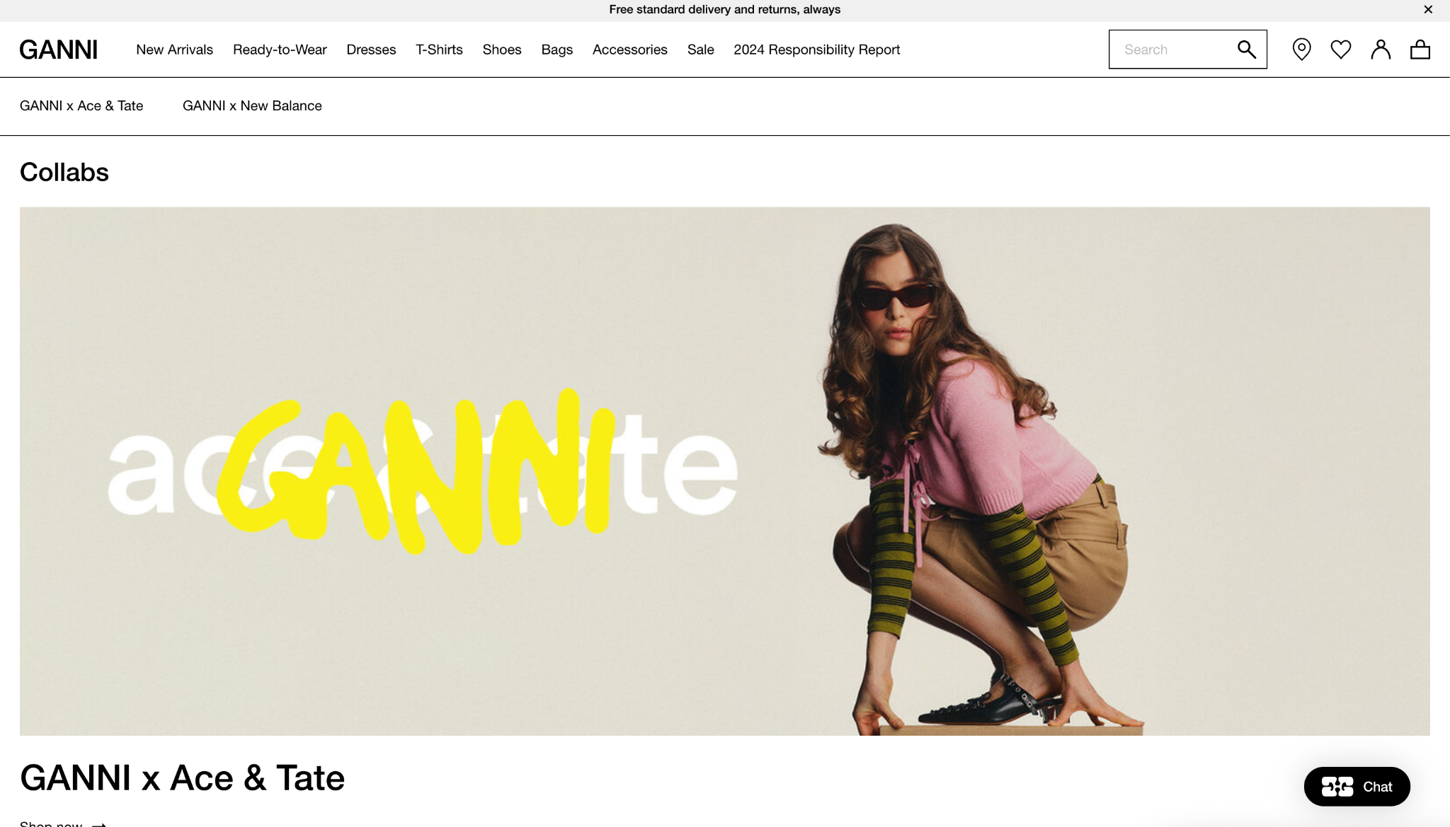
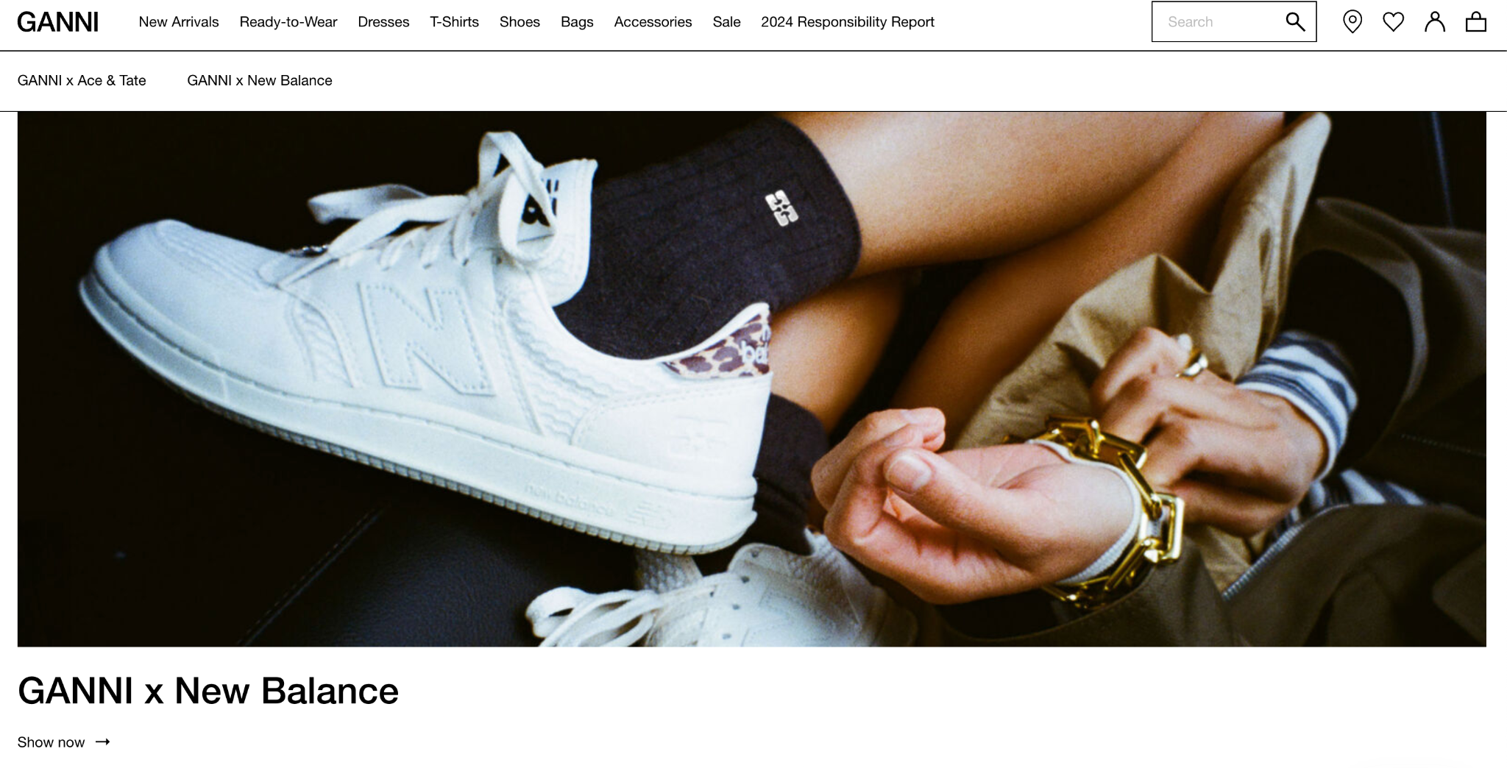
COLLABORATION TAB
https://www.ganni.com/us/collabs.html
Banner size image boxes + minimalistic text

Slide 3
INFORMATION TAB
https://www.ganni.com/us/collabs.html
Banner size image boxes + minimalistic text

Slide 4
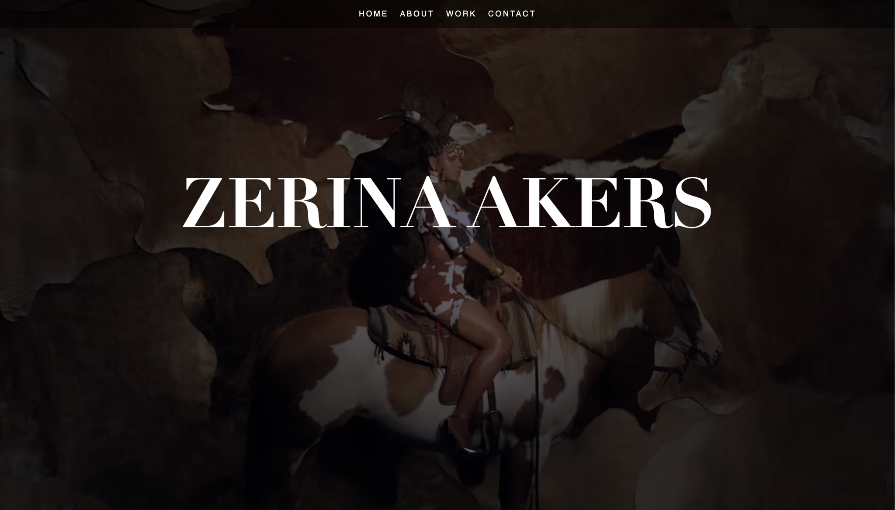
SEEN ON TAB
https://www.zerinaakers.com/ -
Full screen video layout

Slide 5
Vision & Layout Inspiration for My Website
This deck includes references from websites I love, the overall layout I’m drawn to, and the must-have features I’d like to see brought to life for my own site. My goal is to create an experience that feels elevated, editorial, and reflective of my work in the fashion industry.

Slide 6
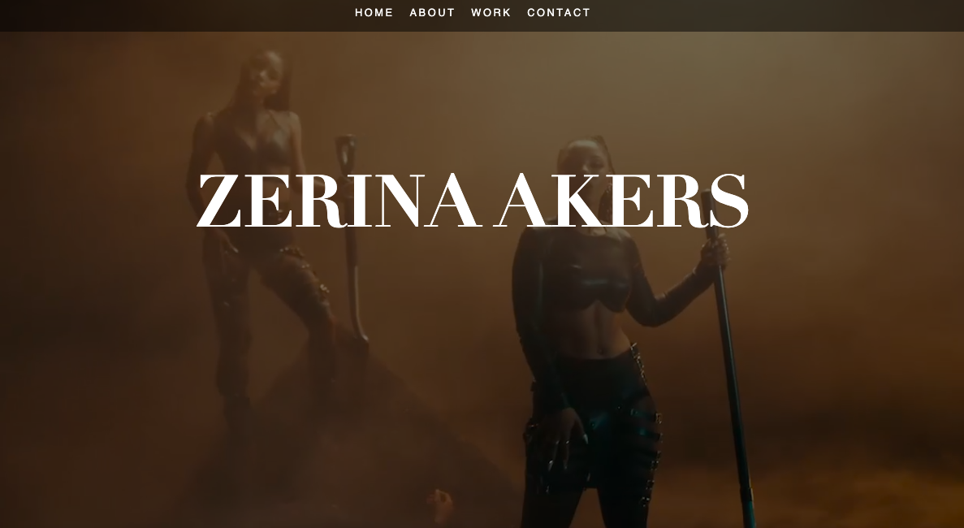

Slide 7
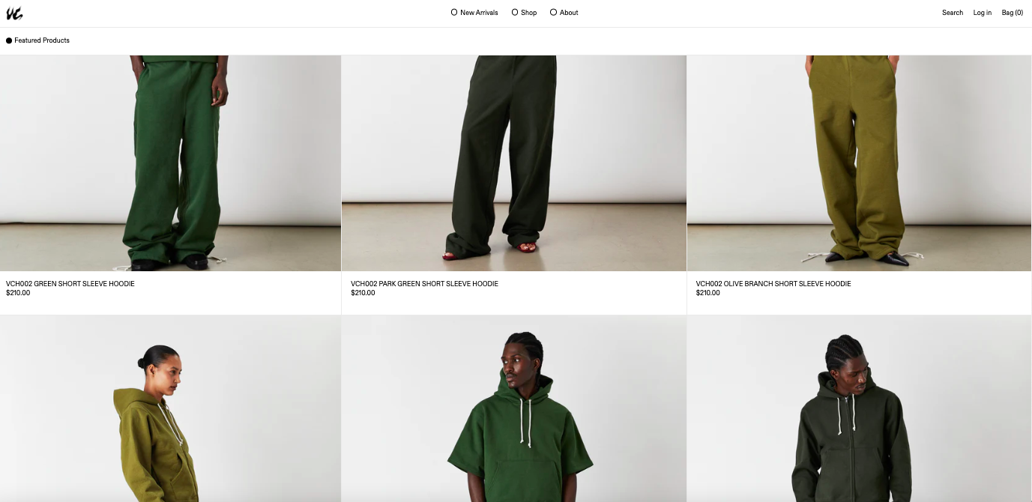
SHOP - i like layout of product
https://www.venedacarter.com/

Slide 8
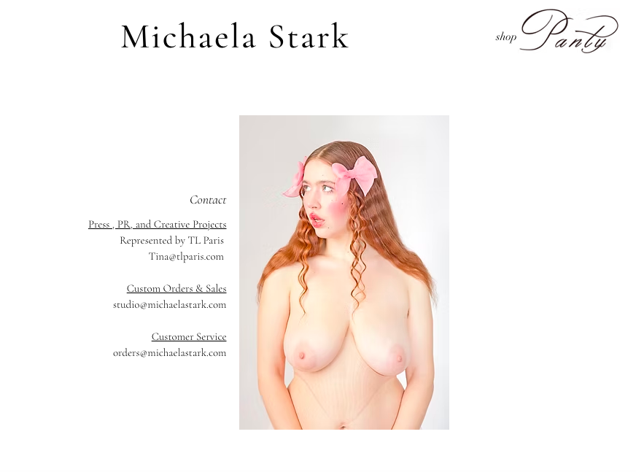
CONTACT PAGE - i like personal photo + information on side of

